Slide 1
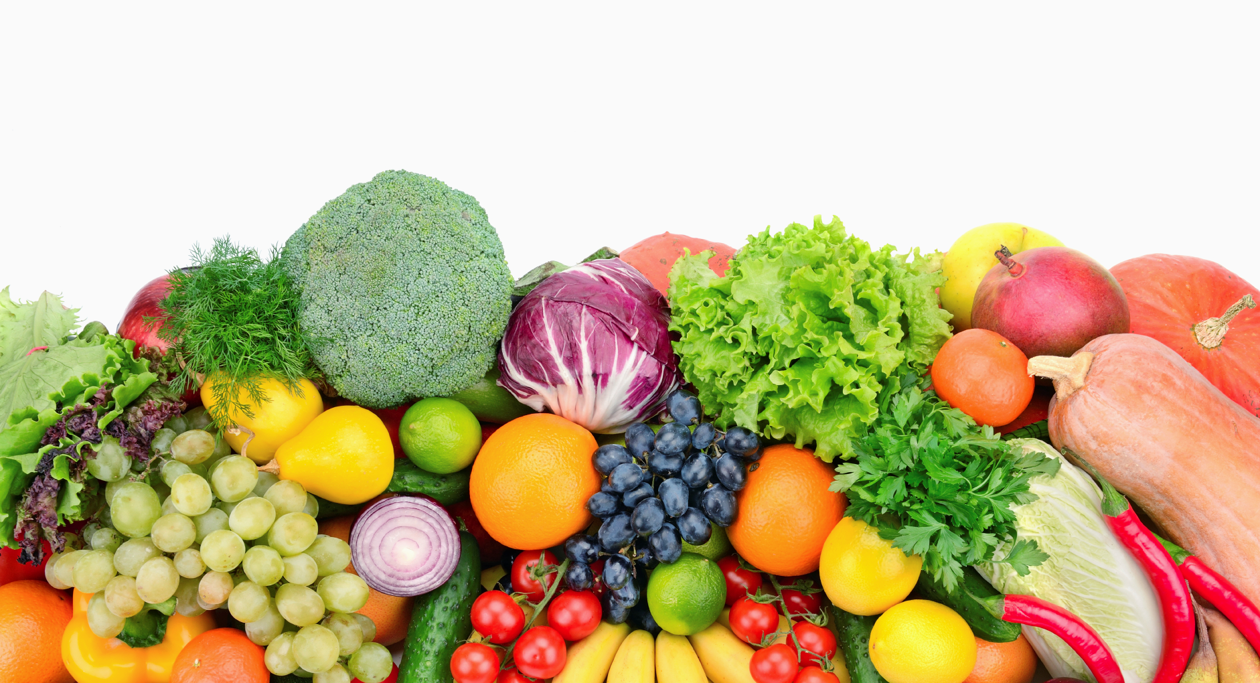
Group 9: Diet Planning Project
SCM702 Final Project
Qingqing Hu
Zhiwei Wang
Nan Zhang

Slide 2
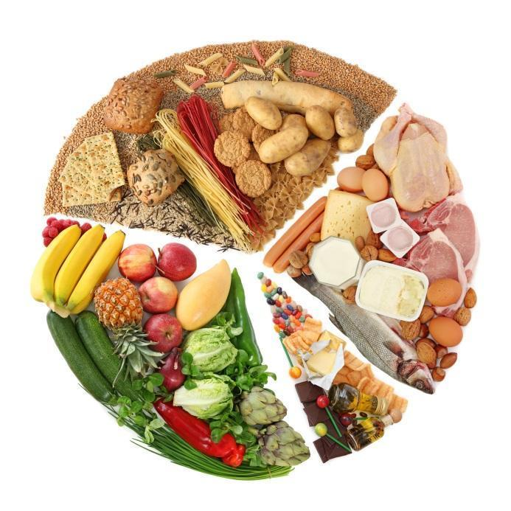
Project Ideas
Decision Variables
The amount of each product
X1 = amount of white bread
X2 = amount of whole-wheat bread
…
X10 = amount of Gala apple
Objective Function
Minimize the cost
Constraints
Basic nutrition needs
Calories >= 2000kcal
Protein >= 50g
Fat <= 70g
Carb >= 260g
Diversity requirements
At least two types of veggie/fruit
Eggs: 1 or 2
At least two types of meat/egg/poultry
...

